Slide 1

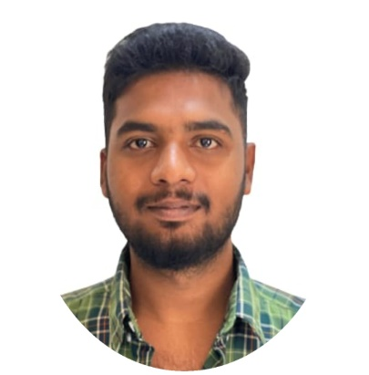





Reddappa C
Education and certificates
Bachelor of Technology Electronics and Communication : 2018- 2021
Analyst/Software Engineer
Skills Spring Boot Spring MVC
JPA CRUD/JPA MONGODB
Semantic ui
Base Location: Bangalore
Email ID:reddappa.c@capgemini.com
_{Mobile No:+917330701078}
Grade:
A4
Backend
Spring Boot/Spring Security MongoDB
REST-API
NodeJS
Strengths
A self driven learner with Front-End and Back-End knowledge.Good knowledge on Python,Spring Boot Passionate about implementing and launching new projects.
Ready to learn new technologies/Frameworks and implement them to further improve my knowledge.
Has working knowledge on Angular and Java Microservice Development using Spring framework on an intermediate level.
.
Achivement
On Demand Car Wash System
Completed case study on Demand Car Wash System along with JWT authentication, Swagger and Billing System using Spring boot Microservices with Eureka Server. Semantic UI and Angular used for admin and user interface.
Database
SQL database – MySQL
No SQL database – MongoDB
Shopping Mall Management System
Web Technologies
HTML5 CSS3
Completed case study of shopping mall management system with crud operation in postman and both on backend and front end.Data base management in no SQL and MY SQL.
Also Implemented Eureka Server and Semantic UI in case study and upskilling day by day.
AddOns Github Maven Postman
Additional Details
Good Communication Skills
Writing Skills
https://github.com/account
Presentation Title | Author | Date © Capgemini 2017. All rights reserved | 1

